Slide 2
SPORT VOLUNTEERING IN EUROPE: REALITIES, OPPORTUNITIES AND CHALLENGES Available online: www.v4v-sport.eu (Library tab)
RESEARCH REPORT

Slide 3

THE V4V PROJECT
Title: “Analysing and making visible the skills acquired through volunteering in sport in Europe”
Acronym: V4V
Funding: Erasmus+ Sport – Collaborative Partnership
EU Priority: Promote voluntary activity in sport
Duration: 36 months - 01 Jan 2021 to 31 Dec 2023 (3 years)
Website: www.v4v-sport.eu

Slide 4



V4V PARTNERSHIP
13 partners
11 different countries
Mix of partners:
Sport Federations
Training Providers
Research Centres
Global Networks
Government
…

Slide 5
SOURCES OF EVIDENCE FOR THE REPORT
Strand 1:
Partner desk research (112 documents)
Strand 2:
Sport volunteer interviews (57 inputs)
Strand 3:
EU and global survey of sport organisations (2 723 responses)
Identification, comparison and discussion of key findings in all strands

Slide 6
ONLINE SURVEY
Focus on Sport Volunteering (1st ever EU Skills Survey on Sport Volunteering?)
Multilingual Survey (English + 17 other languages)
Open May – July 2022
2 723 responses, mainly from grassroots clubs
Organisations engaged approximately 233 000 regular volunteers.
93% of respondents were/had been volunteers themselves.

Slide 7
KEY QUESTIONS AND ANSWERS FROM THE RESEARCH

Slide 8
IS SPORT VOLUNTEERING A BIG DEAL?
Research finds:
Sport has the biggest volunteering workforce in Europe.
Around 12m EU citizens over the age of 15 engage in sport volunteering every year.
They contribute 97m hours of voluntary work per month.
This is equivalent to around 600 000 fulltime posts in sport organisations.
If we had to pay their salaries, that would be around 1,5bn euros every year.

Slide 9
IS VOLUNTEERING IMPORTANT TO SPORT?
92% of the survey respondents said that sport organisations could not provide their services without volunteers.
Volunteers play seven important roles in sport organisations:
Board members and governance,
Administration and management,
Coaching, training, instructing and leading activities,
Officiating (e.g., referees, umpires, judges etc.),
Organising and helping to run sport events,
Maintaining/repairing sport equipment, facilities and grounds,
Supporting day-to-day activities (for example, catering, bar and transport).
Volunteers are in the majority in all of these roles especially in clubs.

Slide 10
WHAT BENEFITS DO VOLUNTEERS GIVE TO SPORT?
From the survey:
60% of respondents said that volunteers provide energy and enthusiasm to sport organisations,
59% said that volunteers are vital in providing logistical support,
50% said that volunteers bring in new participants for sport activities,
40% agreed that volunteers help to build relationships with the local community (which are vital to growing sport participation by ordinary citizens).

Slide 11
WHAT BENEFITS DO VOLUNTEERS GET FROM VOLUNTEERING?
From the survey:
98% said volunteering contributes to volunteers’ personal and social development,
97% said volunteering helps volunteers to develop new skills and competencies,
85% said volunteers appreciate being involved in a sport they feel passionately about,
68% said volunteers like to feel needed, valued and part of a team,
44% said volunteers like meeting new people and making friends,
41% identified ‘having fun’,
34% identified ‘making a difference to the lives of others/helping others’,
31% identified ‘a sense of personal achievement’.

Slide 12
IS SPORT VOLUNTEERING THE SAME ACROSS EUROPE?
Levels of sport volunteering vary greatly across Europe.
Sport volunteering is more common in Northern and Western Europe and less common in Southern and Eastern Europe.

Slide 13
IS SPORT VOLUNTEERING INCLUSIVE AND DIVERSE?
82% of survey respondents said sport volunteering must become more inclusive.
The majority of sport volunteers are:
Male,
Middle-aged (30-55 years),
Well-educated,
Employed in white collar jobs,
Physically active, often sport participants themselves.
Only around 25% of sport organisations reported having volunteers with any form of disability.

Slide 14
WHAT DISCOURAGES PEOPLE FROM VOLUNTEERING?
From the survey:
72% said lack of time
36% said lack of recognition as a volunteer
35% said lack of money
32% said lack of information about volunteering opportunities
30% said the impact of COVID
29% said geographical location/poor public transport

Slide 15
WHAT VOLUNTEER SKILLS/QUALITIES ARE VALUED?
Looking across all desk research, interviews and the survey, the following transversal skills are highlighted:
People skills
Organisational skills
Communication skills
Teamwork skills
Technical skills seem less important. These can be learned.
And the following personal qualities:
Motivation
Reliability
Ethical approach
Cheerfulness

Slide 16
IS IT EASY TO RECRUIT SPORT VOLUNTEERS?
More than half of sport organisations say recruiting volunteers is ‘difficult’ or ‘very difficult’
The most difficult positions to fill with volunteers are:
Sport officials (e.g., referees, umpires, judges etc.) – 71%
Board/committee members – 69%
Coaches/Trainers/Instructors – 67%
Equipment and facility maintenance – 65%

Slide 17
WHAT ARE THE MAIN RECRUITMENT PROBLEMS?
From the survey:
Not enough people interested in sport volunteering – 62%
Not enough people with the right attitudes, motivation or personality – 39%
COVID pandemic – 37%
Lack of organisational capacity to engage volunteers – 27%

Slide 18
HOW DO ORGANISATIONS RECRUIT SPORT VOLUNTEERS?
All areas of research suggest it is mainly personal contact.
From the survey:
From current/past members of the organisation/club – 84%
From parents or family members – 62%
Broader, more proactive methods are not well used.
Only:
33% recruit from the local community
21% from schools and universities
5.3% use volunteer agencies or platforms

Slide 19
ARE SPORT VOLUNTEERS WELL TRAINED?
From the survey:
Only 39% of organisations regularly review their volunteers’ training needs
45% of sport volunteer positions never receive induction training
54% of sport volunteer positions never receive ongoing training
Most learning is informal and on-the-job
The biggest barriers to training are:
Lack of a training budget – 57%
No time or capacity to train volunteers – 51%
Volunteers do not want to take part in training – 41%
Relevant training opportunities are not available – 32%

Slide 20
ARE SPORT VOLUNTEERS WELL MANAGED?
From the survey:
71% of sport organisations do not have written guidelines for managing volunteers
49% have no-one responsible for managing volunteers
Only 50% of organisations provide clothes/uniforms and food/beverage
Only 42% reimburse costs e.g., travel and accommodation
Only 37% provide volunteer certificates, celebrations or other forms of recognition
The biggest problems in managing sport volunteers were:
Volunteers are not always available when we need them – 82%
Volunteers do not have the same motivation as paid staff – 25%
It is difficult to maintain communication with volunteers – 25%

Slide 21
IS IT EASY TO RETAIN SPORT VOLUNTEERS?
From the survey:
71% of sport organisations said it was ‘difficult’ or ‘very difficult’ to keep their volunteers
The biggest problems in keeping sport volunteers were:
Volunteer time constraints – 77%
Changes in volunteer personal circumstances – 56%
Volunteers do not feel their contributions are recognised and celebrated – 31%
The most effective ways of retaining volunteers were identified as:
Thanking volunteers and showing appreciation – 82%
Giving incentives e.g., uniforms, reimbursing their expenses – 51%
Giving volunteers more ownership/influence over the running of the organisation – 49%

Slide 22
KEY LEARNING POINTS (1)
Volunteers are vital resource to sport. Make your organisation volunteer-friendly.
Create a welcoming environment for your volunteers
Provide lots of opportunities for social interaction and teamwork
Listen to your volunteers and involve them decision making and management
Sport volunteering is not the same across Europe.
There is much that countries with low volunteering rates can learn from the countries who are doing better (with appropriate cultural adjustments).
Sport volunteering is not yet inclusive and diverse.
Actively look for more female volunteers.
Identify and remove barriers to volunteers with disabilities.
Reach out to people who have more time to volunteer, e.g., students, unemployed and people in retirement

Slide 23
KEY LEARNING POINTS (2)
Be more proactive/imaginative when you recruit volunteers
Do not just rely on current members, parents and family members
Advertise volunteering opportunities and use recruitment methods which reach the local community
Focus on the things which motivate sport volunteers, e.g., passion for the sport, opportunities for social interaction, fun and enjoyment, desire to help others
Look for people who have the right personal skills and qualities
Transform temporary event volunteers into regular volunteers who can take on other roles
Offer ‘micro-volunteering’ opportunities which do not require so much time.

Slide 24
KEY LEARNING POINTS (3)
Volunteers want to learn new skills and competencies – give them training.
Find out what training your volunteers need and want
Allocate some of your budget to volunteer training
Improve your capacity to train your volunteers
Look for opportunities to coordinate volunteer training with other clubs/organisations
Improve your volunteer management.
Have guidelines for managing your volunteers and make one person responsible
Be flexible in finding volunteering roles which match people’s interests, skills and available time
Maintain regular communication with your volunteers

Slide 25

KEY LEARNING POINTS (4)
More than anything else, always show gratitude and respect for your volunteers’ efforts – CELEBRATE their achievements!

Slide 26
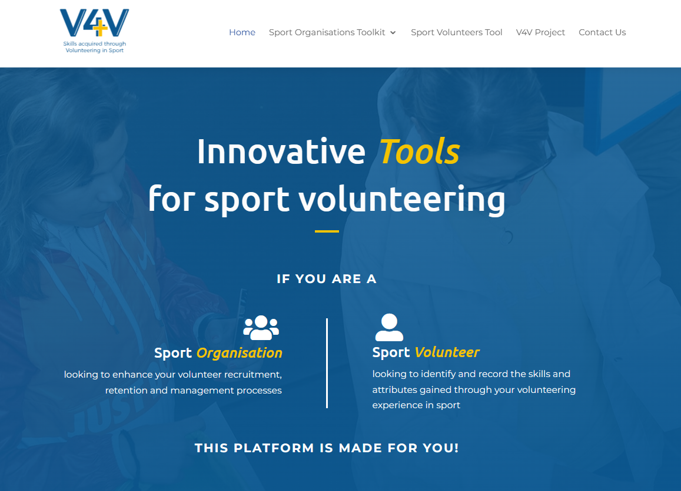
ADDITIONAL V4V PRODUCTS
Interactive online toolkit for sport organisations so they can assess their strengths and weaknesses in regard to volunteer engagement and access relevant learning resources and good practice case studies.
Interactive online self-reflection tool for sport volunteers so that they can identify the competencies, skills and personal qualities they have developed through volunteering to help them build their CVs/resumés.
Access to this platform will be available in early February.

