Slide 1
Présentation

Slide 2




Presentation of F.F. Clubs Omnisports :
22 employees
Personalised support
Legal advises
586 associations members
82% employers

Slide 3


Table of contents
01. France benevolat : Study of volunterism in France
02. Volunterism Committee
03. Omnisports pour elles

Slide 4






01. France benevolat : study of volunterism in France
Volunteers in sport associations = 360 000 full time jobs
46% of women
Younger
Oldest
Expectations and motivations
Parents and people with higher revenues are more present

Slide 5



02. Volunterism commitee
Meetings and share of experience
Creation of tools and documents
Plaforms to find volunteers

Slide 6

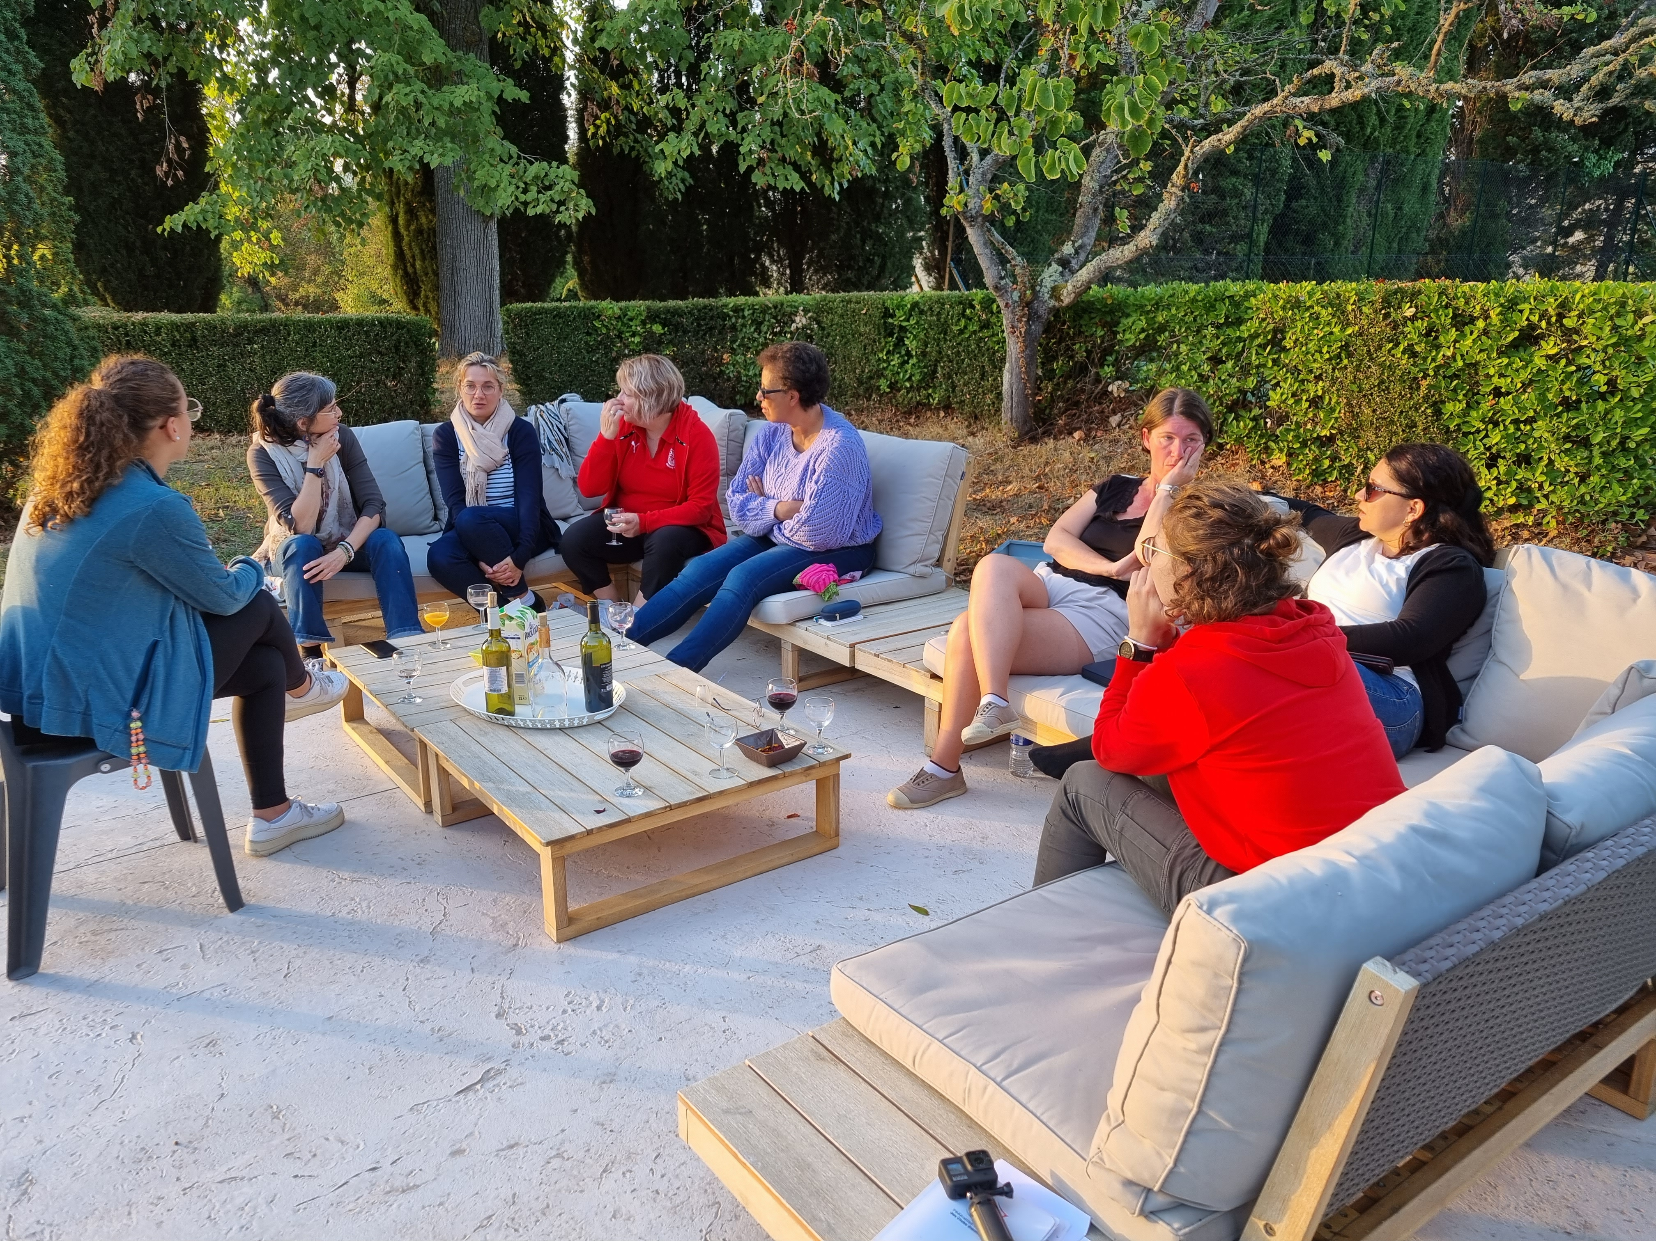
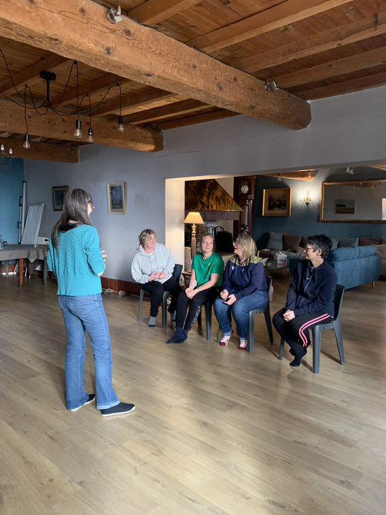
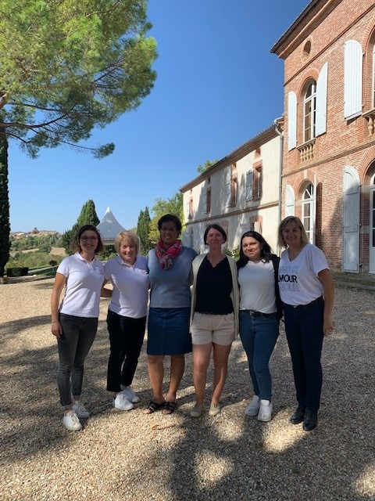
Share experience
Group discussions, testimonies, actions
03. Omnisports pour elles
Develop skills
Personnal development, speaking in public, handling pressure.
Looking for parity in the governance bodies of sport organizations
Take responsabilities
More confidence to take higher responsabilities

Slide 7
ffco@ffco.org – 01 42 53 00 05
53 rue Raymond Marcheron
92170 VANVES

